Slide 1
CMP 262 Data Science Programming Final Project
Asma Akhtar

Slide 2

“Student-Health-Data”
Introduction: The student-health data is used for studying a range of health-related facts on college students.
Areas: Academic, Psychological, and Physiological information can be obtained.
Sensor-based measurements as well as self-reported values.

Slide 3

ABOUT THE DATA
The data was sourced from Kaggle, csv file and read into the jupyter notebook.
Key features: demographic info, physiological data, physical activity and sleep quality, and health risk level.
Who could benefit:
Universities
Colleges
Researchers
Providers

Slide 4

Packages used:
Pandas
Matplotlib
Seaborn
Scipy

Slide 5
What is the question behind your analysis? How can we better use current data on student stress to discover specific causes and solutions that successfully reduce stress and increase overall student well-being?"
The study explores the relationships between major components of student health, including physical activity, sleep quality, mood, and self-reported stress levels.
The major goal is to identify helpful information that will help students enhance their well-being and efficiently manage stress.

Slide 6
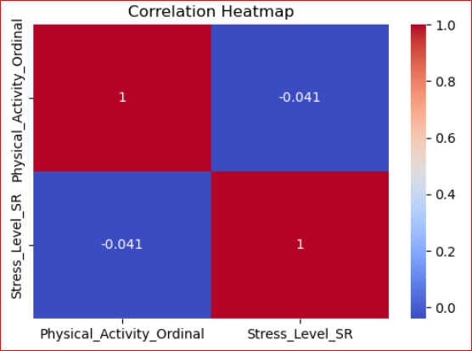
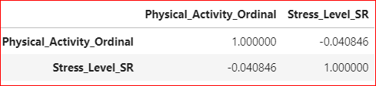
First Question: How does physical activity level (Low, Moderate, High) correlate with self-reported stress levels (Stress_Level_Self_Report)?
Answer: Correlation between Physical Activity level and Self-Reported Stress is -0.04

Slide 7
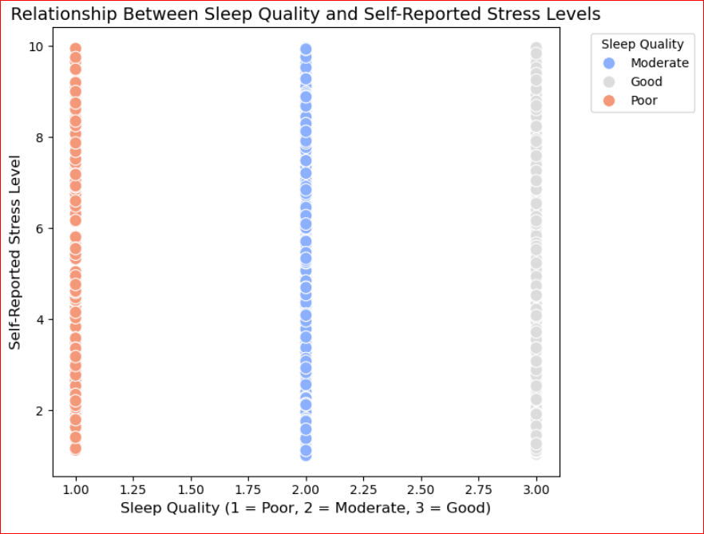
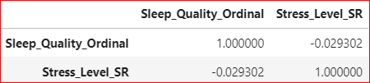
Question #2 How do different levels of sleep quality (Poor, Moderate, Good) correlate with self-reported stress levels (Stress_Level_Self_Report)?
Answer: Correlation between Sleep Quality and Self-Reported Stress: -0.03

Slide 8
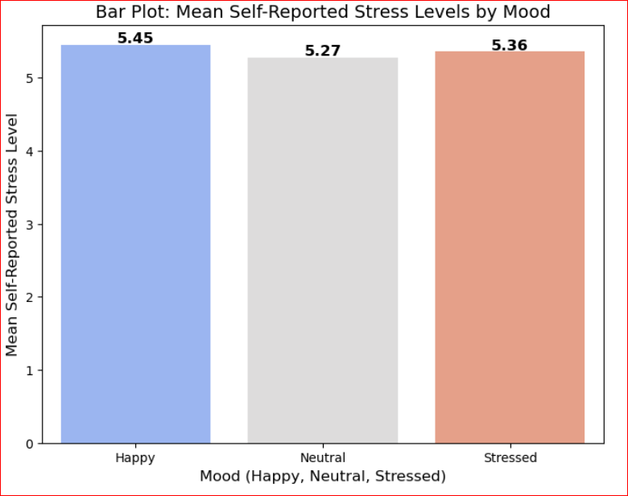
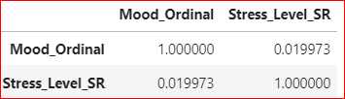
Question #3: How do self-reported moods (Happy, Neutral, Stressed) correlate with self-reported stress levels?
Answer: Correlation between Self-Reported Mood and Self-Reported Stress Level: 0.02

Slide 9
What still needs to be answered and New Questions to pursue:
How can we use the available data to develop more accurate models that predict student stress levels based on actual actions, circumstances, and demographic information?
How do breakfast habits affect stress and overall health outcomes?
What role does academic workload play in influencing student stress?

